Slide 1
Neural Network with Feedback Control through Gain Modulation
Jerry Jin

Slide 2
1. Introduction

Slide 3
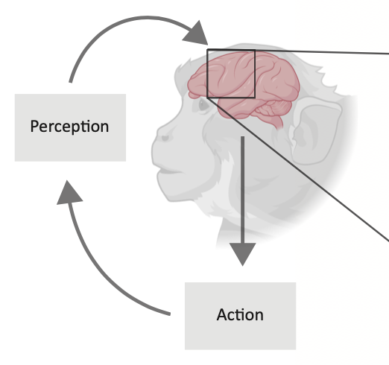
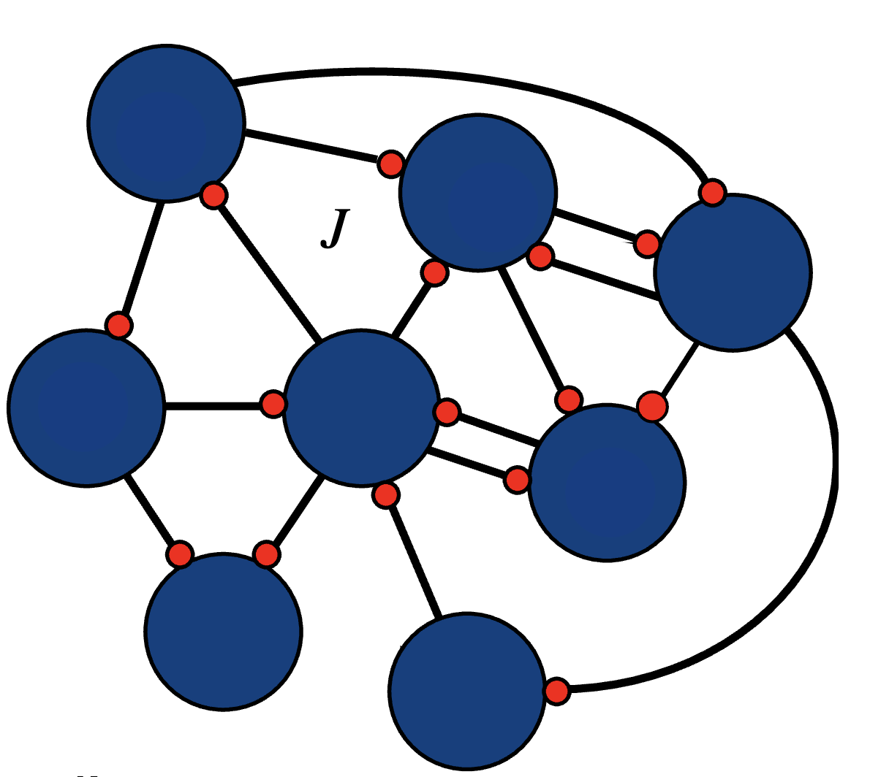
1. Introduction: Feedback Control
Feedback control is central to intelligent behavior
W
Feed-forward Control System
Feedback Control System
System
Inputs
Dynamical
System
System
Outputs
System
Inputs
+
Dynamical
System
System
Outputs
Feedback
Controller
Notes:
As we all know, a purpose of the brain is to produce behaviors, and this is accomplished using feedback.
Until now, neuroscientists have found many feedback control systems in the brain.
For example, sensory consequences of arm reaches provide feedback used to control the arm, and feedback control provides a normative explanation of many aspects of reaching.
Control theory distinguishes between systems that use feedback to correct errors, feedback control system, and those that do not, feedforward control system.
For the feedforward system, the output is totally determined by its input. An example of the feedforward system is the eye blink reflex. Feedforward control is good for such direct functionalities. But it could not prevent perturbations. If there are unexpected perturbations in the system, the output would deviate from the target.
To correct such errors, we need feedback control. For example, when reaching to a target, we would have to use the feedback sensory information to adjust our arm movement if the target moves a little bit.

Slide 4
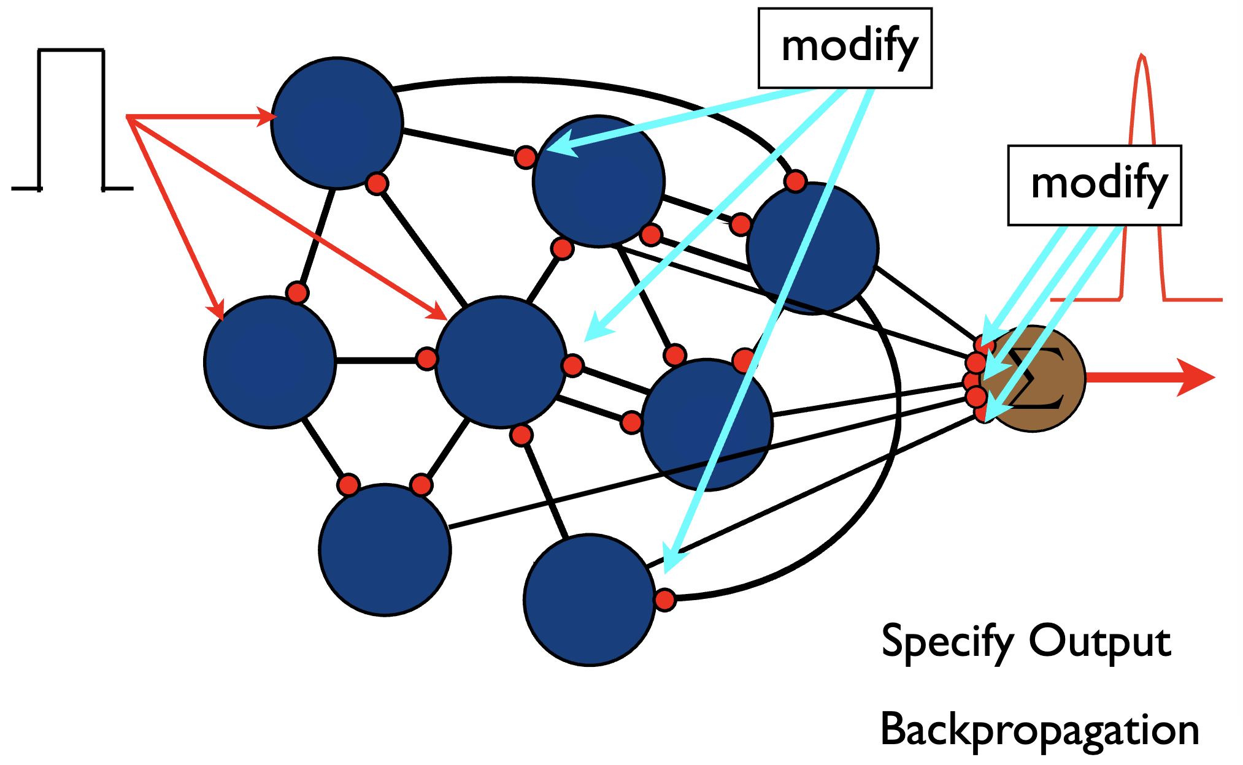
Introduction: Problematic Backpropagation
Conventionally, we backpropagate errors to synaptic weights to train the neural network, but it is not biologically realistic
The brain uses Hebbian learning to update synaptic weights, but it is slow and unsupervised
Notes:
Biologically realistic model?
Backpropagating errors on synaptic weights are problematic
Hebbian learning is the usual way to adjust weights, but it is slow and unsupervised, the brain must have some ways to exert feedback control rapidly and to guide Hebbian learning

Slide 5
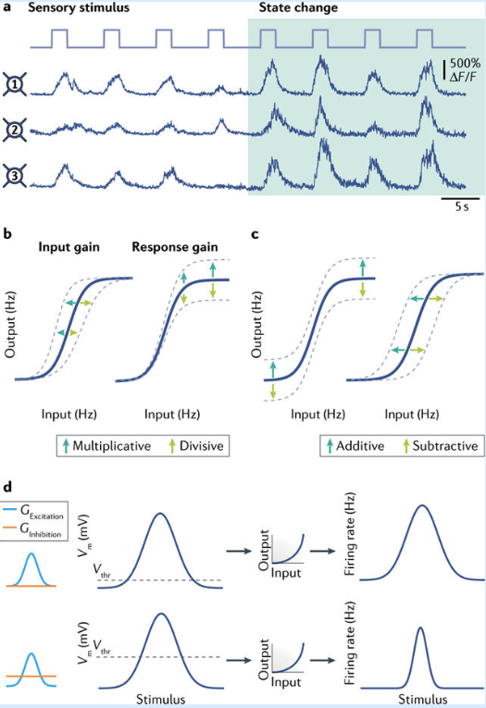
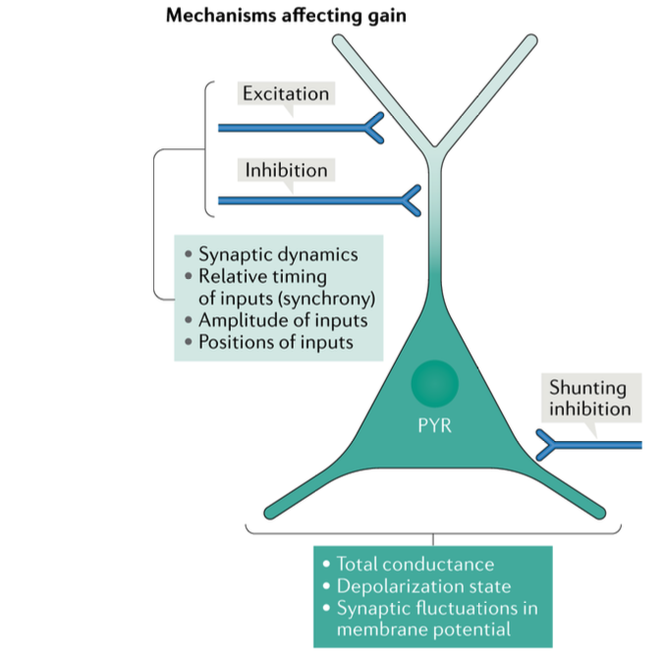
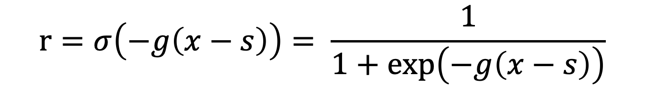
1. Introduction: Gain Modulation
How is rapid feedback control exerted?
Response modulation is a robust experimental phenomena
Gain Modulation
Shift Modulation
$$r=σ\left(−g\left(x−s\right)\right)= \frac{1}{1+\exp\left(−g\left(x−s\right)\right)}$$
Ferguson & Cardin (2020)
Notes:
How is feedback control rapidly exerted in the brain?
One way that neuroscientists found is through response modulation
The one we will focus on: Gain modulation that is, the gain or sensitivity of a neuron to inputs is altered, while the selectivity is preserved.
Gain modulation is a kind of multiplicative modulation, in the sense that a change in slope without a change in the action potential threshold.
In contrast, additive modulation, for example, shift modulation, maintains the shape of the curve and shift the input/output relationships uniformly for all input values. This maintains the sensitivity of a neuron but alter the input required to reach the threshold for a response, thereby changing stimulus selectivity.
Indeed, gain modulation is a robust experimental phenomena. Researchers have found many cellular mechanisms that could result in gain modulation

Slide 6
1. Introduction: Our Vision
A biologically realistic neural network for learning, using feedback control through gain modulation and Hebbian learning on synaptic weights.
Transfer of learning from gains to weights
Feedback control quickly makes the network to output the target
Hebbian learning gradually adjusts the synaptic weights
The network eventually outputs the target without the need of control
Notes:
Idea: feedback control signal on gains (and shifts) while use Hebbian learning to adjust weights
Our research goal: a biological realistic neural network for learning, using feedback control through gain modulation and Hebbian learning

Slide 7
2. Feedback Control and Gain Modulation in Feedforward Network

Slide 8
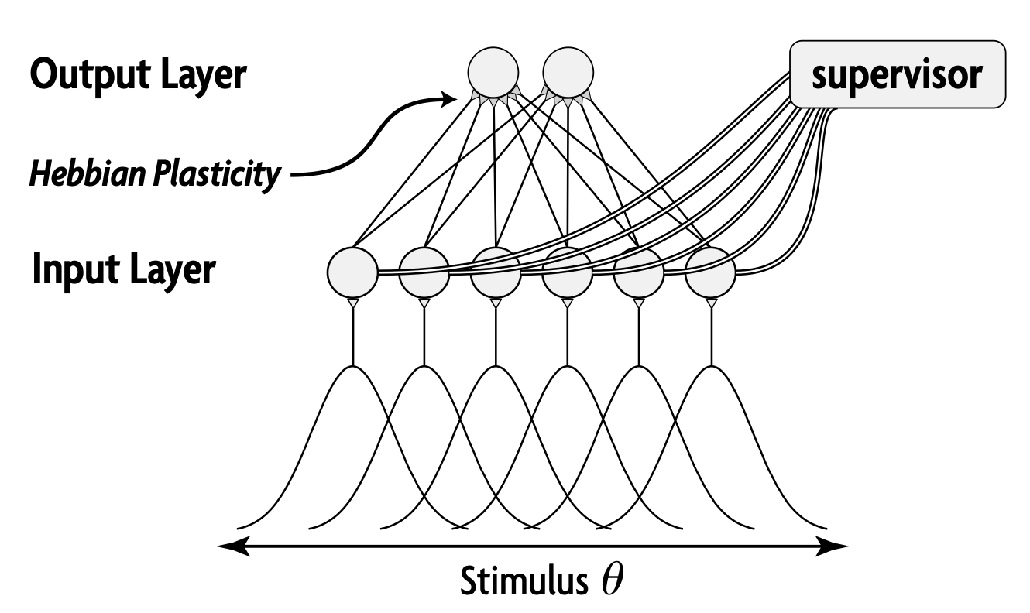
2. Feedforward Network
Structure:
Feedforward network
Sigmoid activation function (with adjustable gains and shifts)
Feedback control on gains (and shifts)
Hebbian learning on synaptic weights
Properties:
Transfer of learning from gains to weights
Adaptation under perturbation
Swinehart and Abbott (2005)
Notes:
First, I realized our goals on the feedforward network
Mostly a replication, verify the adaptation property

Slide 9
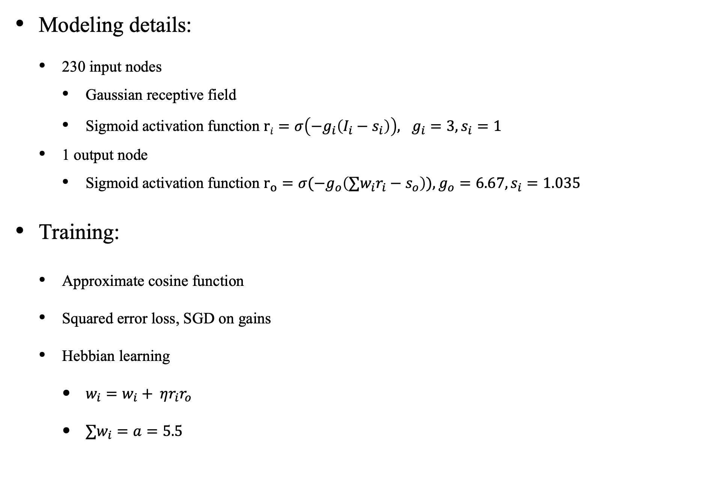
2. Feedforward Network
Modeling details:
230 input nodes
Gaussian receptive field
Sigmoid activation function $ri=σ\left(−g_{i}\left(I_{i}−s_{i}\right)\right), g_{i}=3, s_{i}=1$
1 output node
Sigmoid activation function $r_{o}=σ(−g_{o}\left({∑w_{i}r}_{i}−s_{o}\right)), g_{o}=6.67, s_{i}=1.035$
Training:
Approximate cosine function
Squared error loss, SGD on gains
Hebbian learning
$w_{i}=w_{i}+ ηr_{i}r_{o}$
${∑w}_{i}=a=5.5$
Notes:
Swinehart and Abbott (2005) trained a neural network based on gain modulation. They use a supervisor to modulate shifts and gains, rather than directly on synaptic weights. They then use normalized Hebbian learning to change the synaptic weights, which could transfer the learning to synapses and finally making the supervisor unnecessary. They are able to use this network to approximate arbitrary functions.
The gain and shift in output is actually not the same as the paper

Slide 10
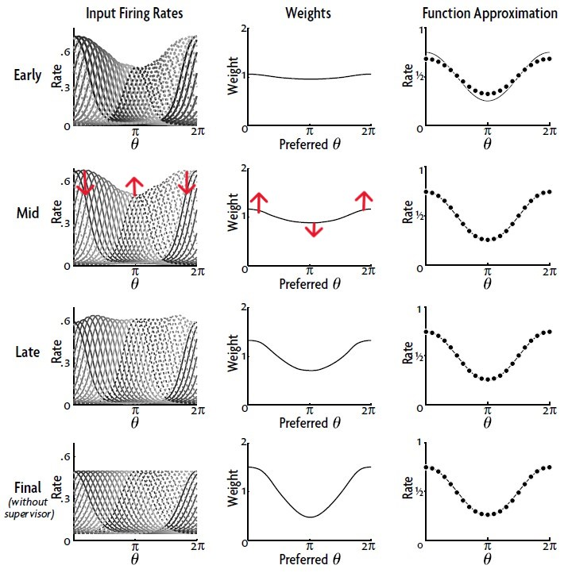
2. Feedforward Network
Transfer of learning from gains to weights
Swinehart and Abbott (2005)
Notes:
Ideally, after doing backprop on gains and shifts, the response tuning curves of side neurons would go up and those of middle neurons would go down. Then, when hebbian learning is turning on, the weights of side neurons would get larger update than those of middle nuerons. Plus, the normalization process would keep the sum of the weights as constant, resulting in a cosine-like weights. The changed weights would "exaggerate" the model outputs (e.g., even lower outputs in the middle of the curve). So, to reduce the loss, The next rounds of backprop would flatten the response tuning curves. In theory, this process transfers the learning in gains and shifts to weights.

Slide 11
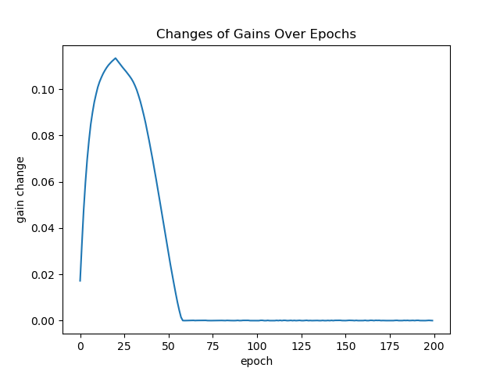
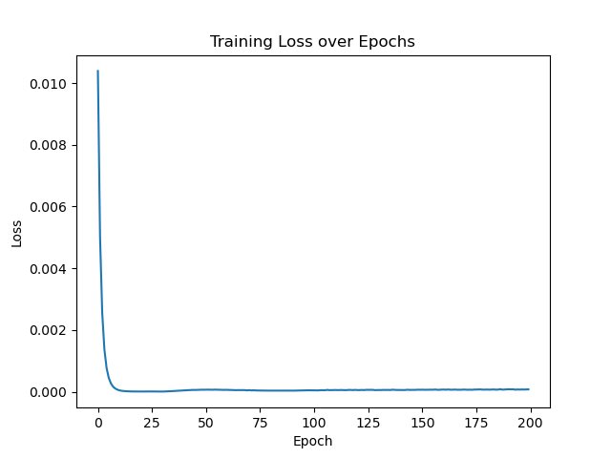
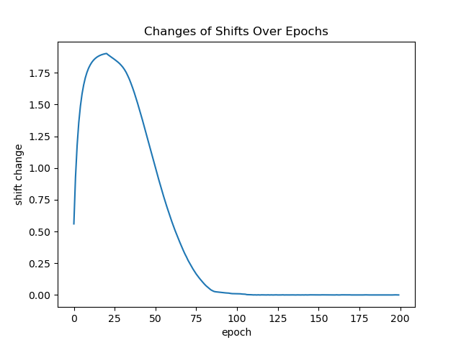
2. Feedforward Network
Transfer of learning from gains to weights
Notes:
Training is successful

Slide 12
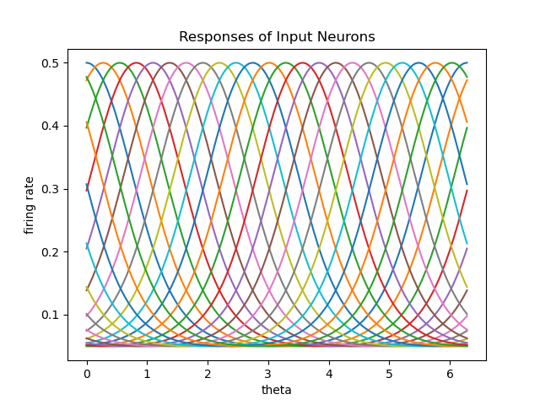
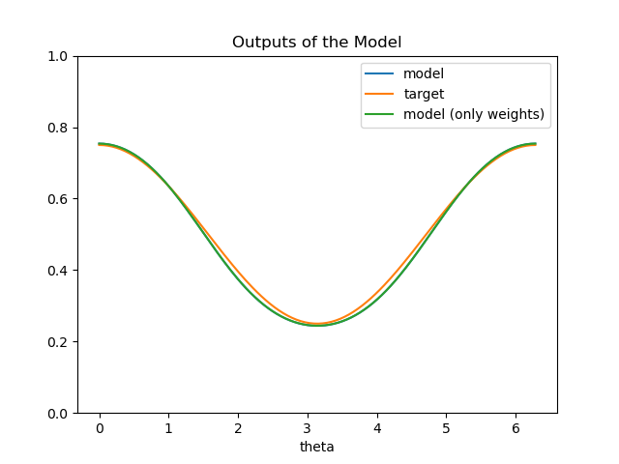
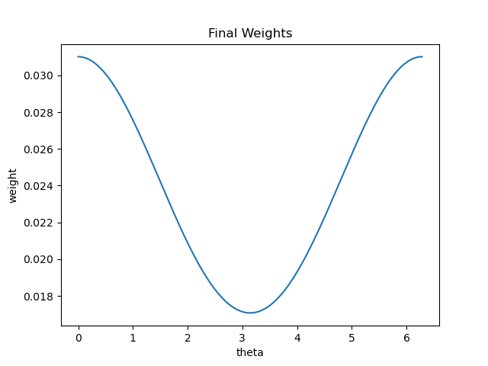
2. Feedforward Network
Transfer of learning from gains to weights
Notes:
Final stage, response curve for input neurons back to initial
Using initial gains and shifts, fit well

Slide 13
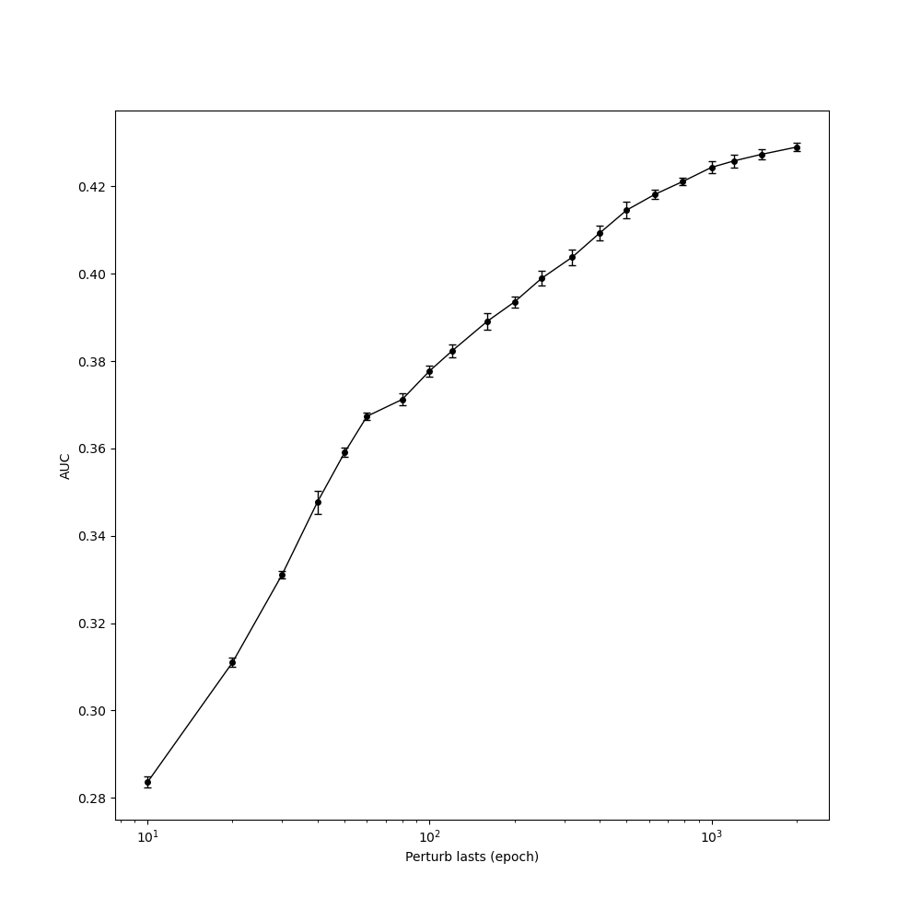
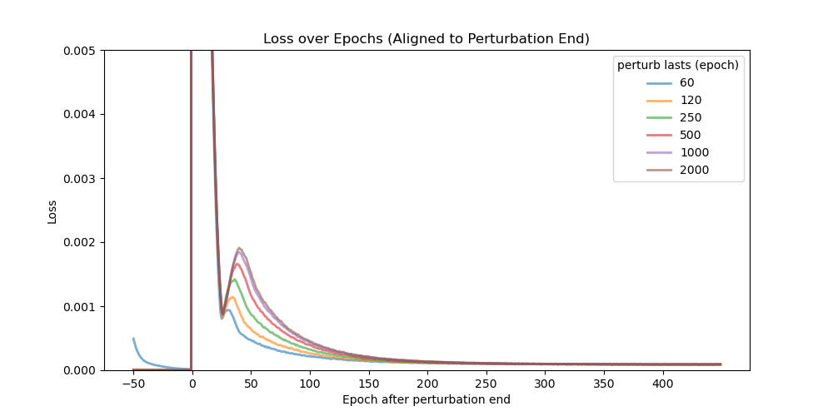
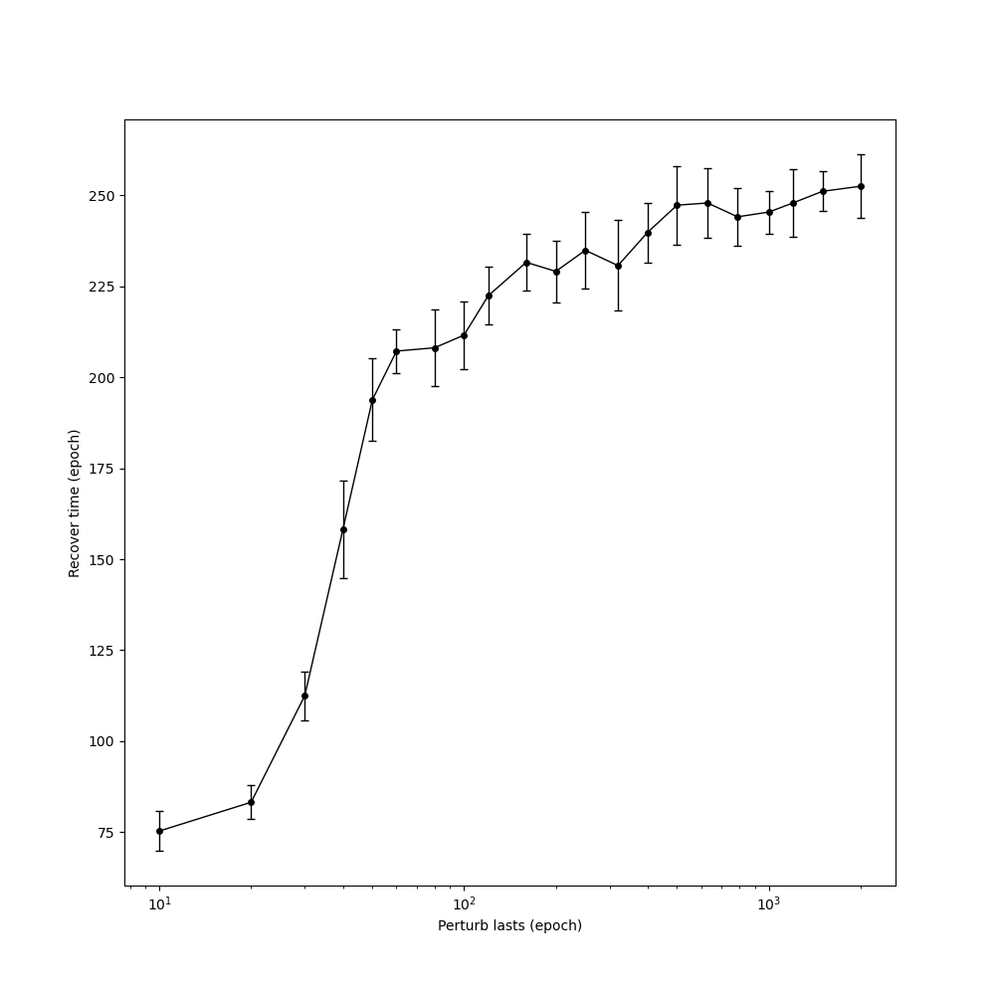
2. Feedforward Network
Adaptation under perturbation
In the trained feedforward network, add a persistent noise on all nodes at 50th epoch, last for different epochs, and then turn off
Notes:
Perturbation experiment
Mimic the adaptation phenomena in psychology
To quantify, I define two metrics, AUC and how long it takes to return to a low loss

Slide 14
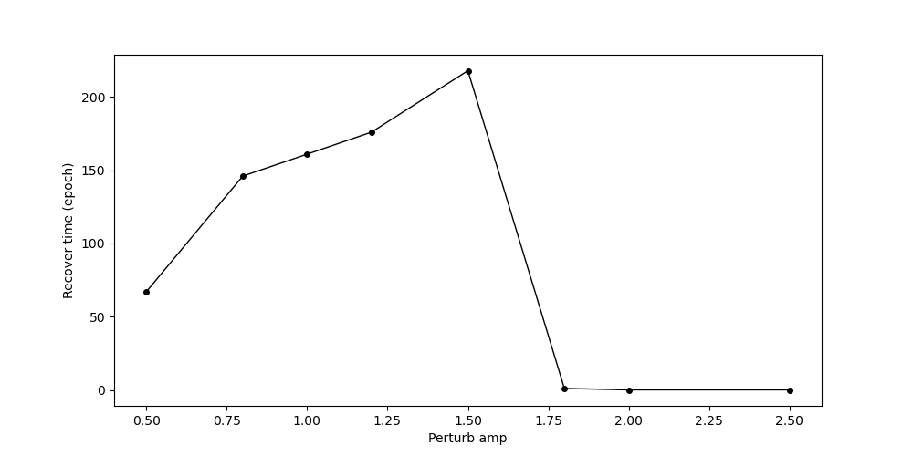
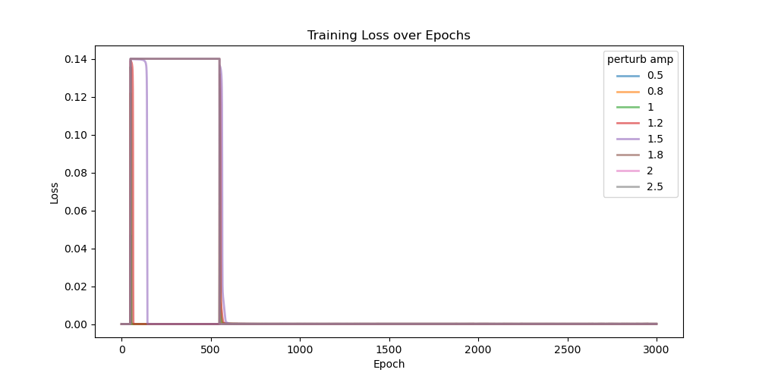
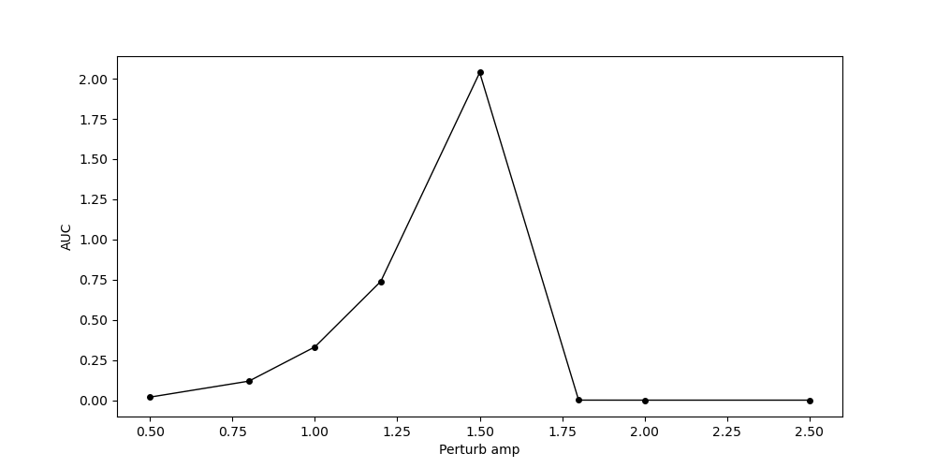
2. Feedforward Network
Adaptation under perturbation
In the trained feedforward network, add a persistent noise on all nodes at 50th epoch with different amplitude, last for 500 epochs, and then turn off
Notes:
Each perturbation lasts for 10 simulations

Slide 15
2. Feedforward Network
Replace SGD with control theory?
Scaling problem?
Multilayer network? [Mingoo]
Modeling details:
230 input nodes
Gaussian receptive field
Sigmoid activation function $ri=σ\left(−g_{i}\left(I_{i}−s_{i}\right)\right), g_{i}=3, s_{i}=1$
1 output node
Sigmoid activation function $r_{o}=σ(−g_{o}\left({∑w_{i}r}_{i}−s_{o}\right)), g_{o}=6.67, s_{i}=1.035$
Training:
Approximate cosine function
Squared error loss, SGD on gains
Hebbian learning
$w_{i}=w_{i}+ ηr_{i}r_{o}$
${∑w}_{i}=a=5.5$
Notes:
When using original parameters, I found the output has the correct shape but different scales – the scaling problem
Nothing special for 3 and 1

Slide 16
3. Feedback Control and Gain Modulation in RNN

Slide 17
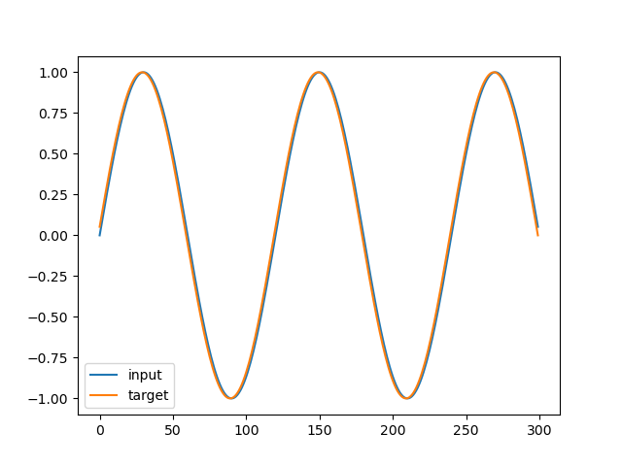
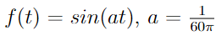
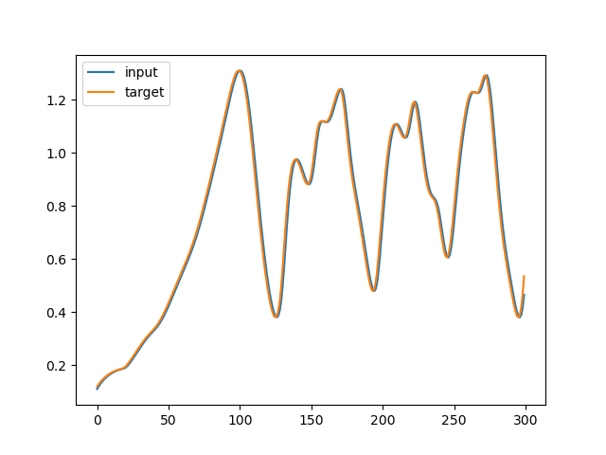
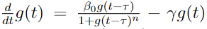
3. RNN
Task 1: Sine wave
Input f(t), predict f(t+1)
Task 2: Mackey–Glass equation
Input g(t), predict g(t+1)
Notes:
The two tasks that we now let the model to perform are: first, predicting a simple sine wave, and second, predicting the Mackey-Glass equation.

Slide 18
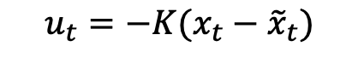
3. RNN
Train with SGD first (on gains and shifts), and then simulate under perturbation and feedback control on gains
Perturbation
$$x_{t+1}=σ\left(−(g+u_{t})\left(z_{t}−s\right)\right)$$
W
$$z_{t}=Wx_{t}+I_{t}+d_{t}$$
d_{t}
Input weights
Readout weights
I_{t}
x_{t}
u_{t}
Input
Output
Nonlinear LQR
Extended Kalman Filter
$$u_{t}=−K(x_{t}−{\tilde{x}}_{t})$$
128 nodes, 50% excitatory neurons, 50% inhibitory neurons
Notes:
For the simulating part, it is under working. What I have realized now is to apply feedback control on gain.
Against perturbation for trained network
It deviates a bit from our vision.

Slide 19
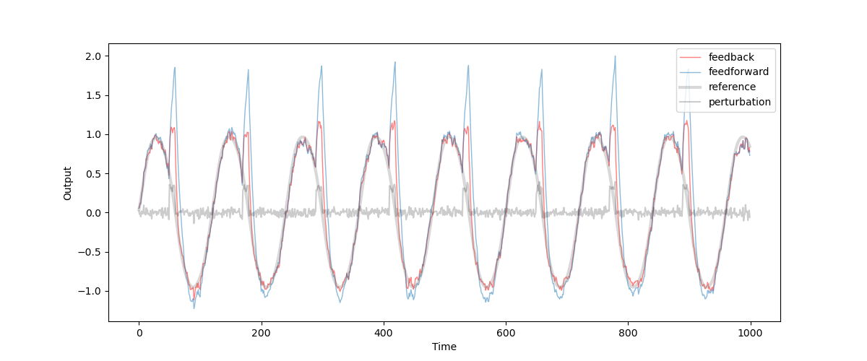
3. Feedback Control and Gain Modulation in RNN
Sine wave, simulating under periodic perturbation:
Notes:
We inject periodic perturbation to the system.
The yellow line is the same system without feedback control, the blue line is the system with feedback control.
As we can see, the feedback control does help the system to return to the right track more quickly after perturbation.

Slide 20
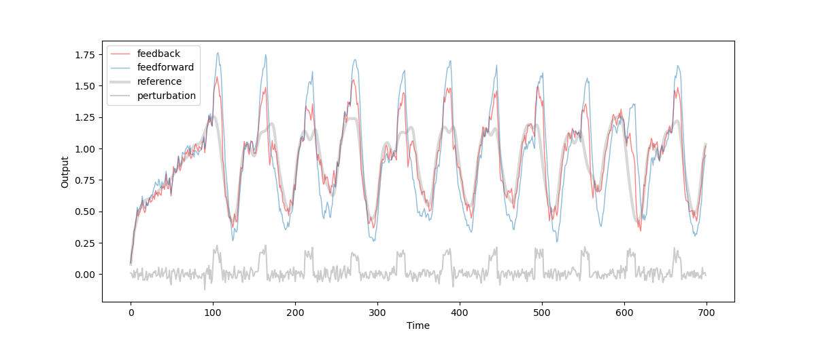
3. Feedback Control and Gain Modulation in RNN
Mackey–Glass equation, simulating under periodic perturbation:
Notes:
The same for the Mackey-Glass equation. A bit more messy.

Slide 21
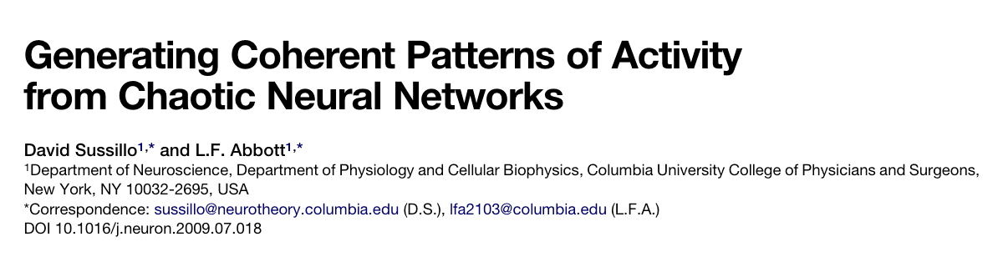
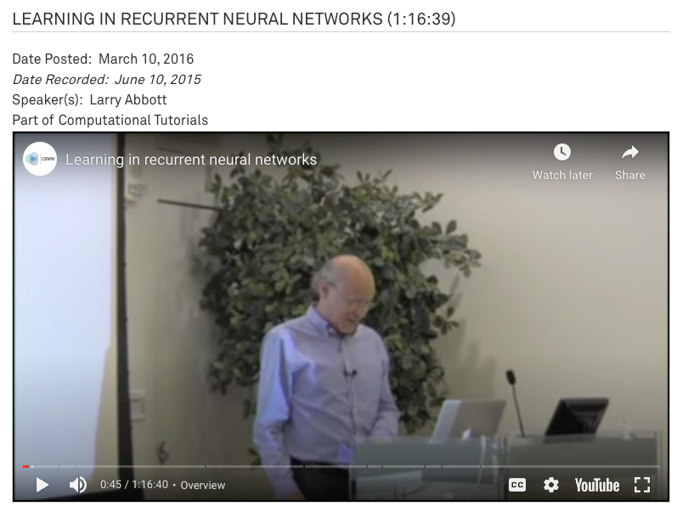
3. RNN

Slide 22
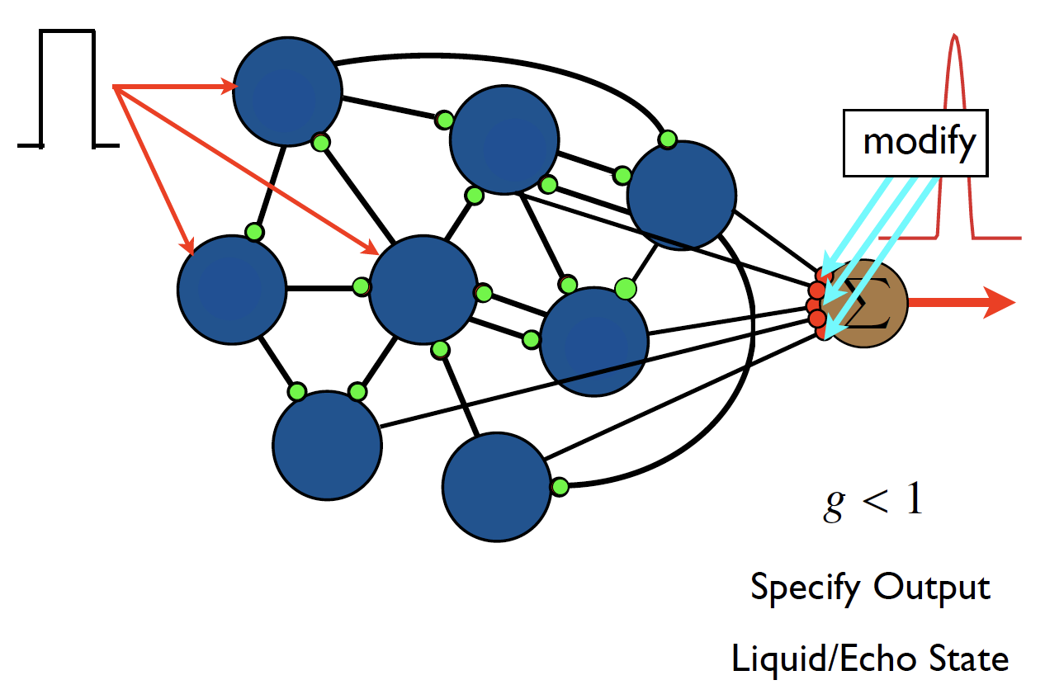
3. RNN
Notes:
Force learning idea!

Slide 23
3. RNN
SGD + Hebbian learning on recurrent weights: diverge… can’t understand (for now)
Make life easier: Hebbian learning only on readout matrix

Slide 24
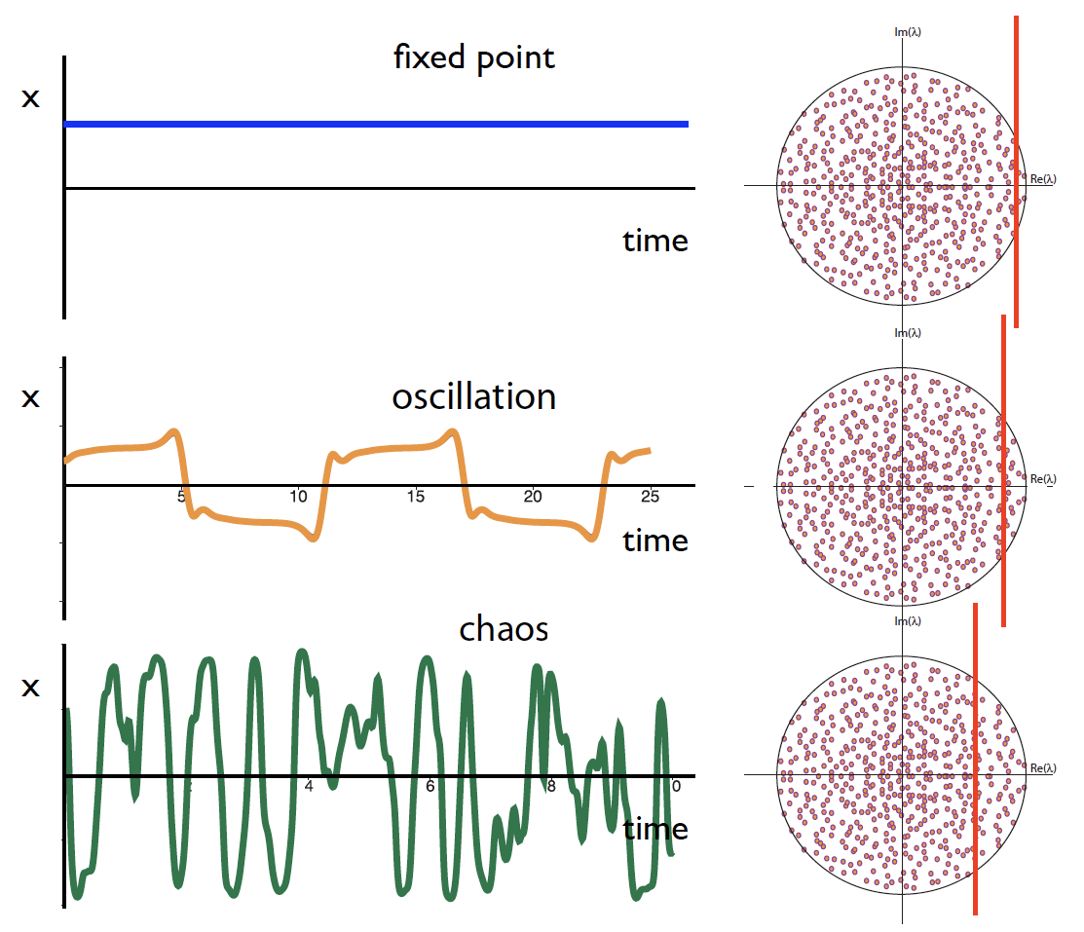
3. RNN

Slide 25
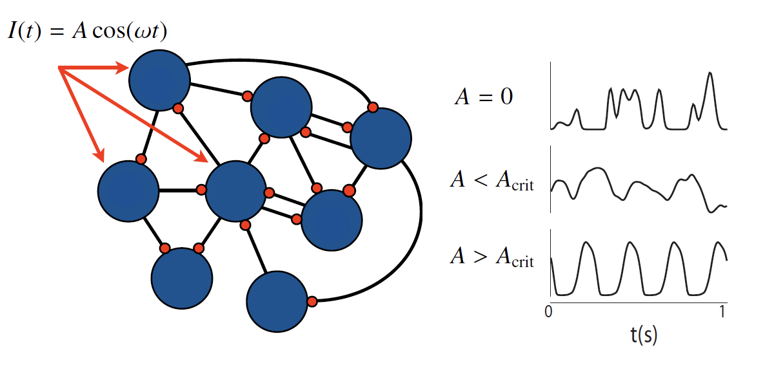
3. RNN

Slide 26
3. RNN
W
Readout weights H
I_{t}
y_{t}
Output z_{t}
Input
x_{t}
Sine wave with random phases

Slide 27
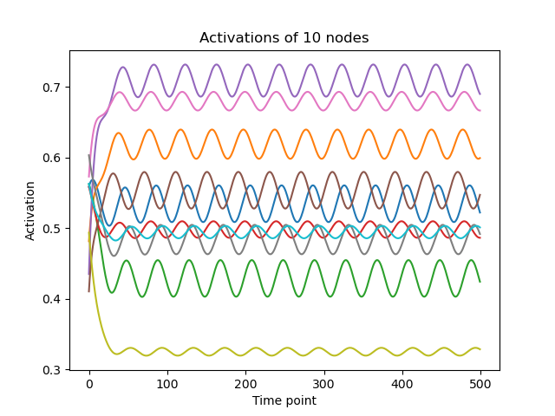
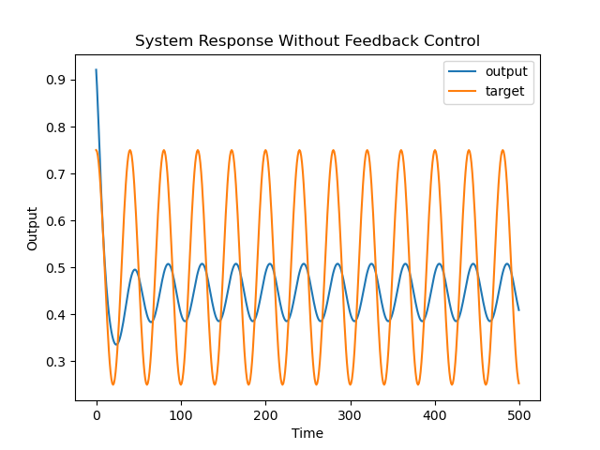
3. RNN

Slide 28
3. RNN
Structure:
Recurrent neural network (RNN)
Sigmoid activation function (with adjustable gains and shifts)
Dale’s Law
Feedback control on gains
Hebbian learning on synaptic weights (readout weights)
Properties:
Transfer of learning from gains to weights

Slide 29
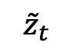
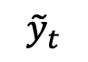
3. RNN
Step 1: Make the initial network to output the target using feedback control
W
$$x_{t+1}=σ\left(−(g+u_{t})\left(Wx_{t}+I_{t}−s\right)\right)$$
Readout weights H
I_{t}
y_{t}
Output z_{t}
Input
x_{t}
$${\tilde{y}}_{t}$$
$${\tilde{z}}_{t}$$
Sine wave with random phases
u_{t}
Nonlinear LQR
200 nodes, 50% excitatory neurons, 50% inhibitory neurons

Slide 30
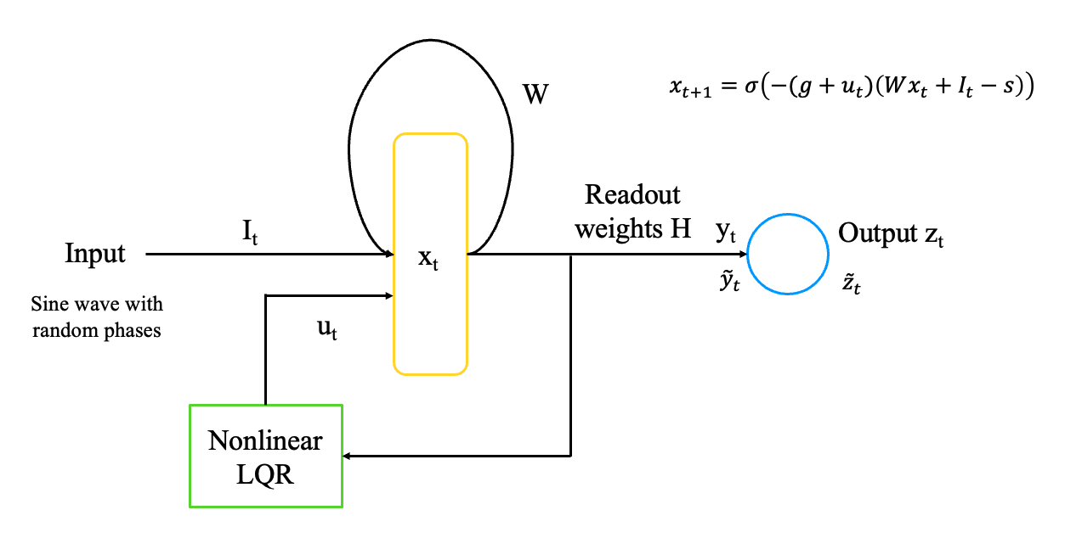
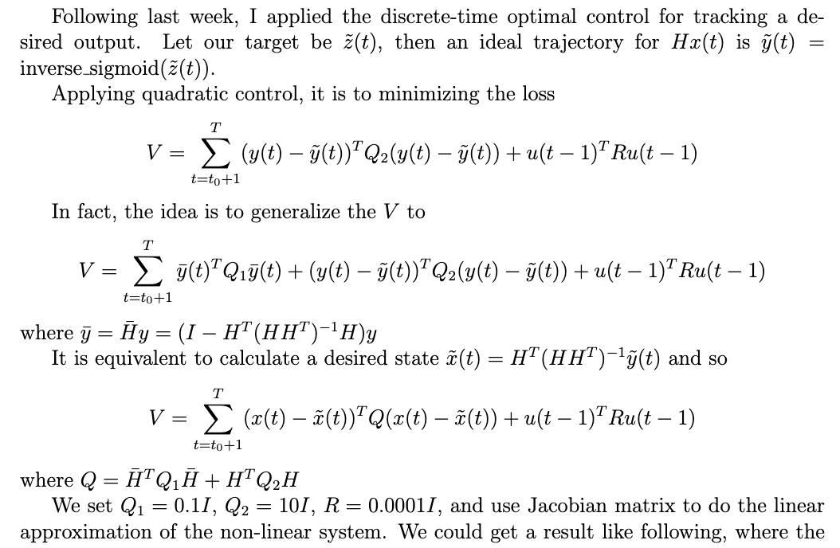
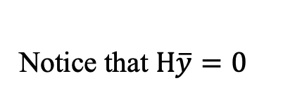
3. RNN
Notice that $H\overline{y}=0$
Notes:
y=Hx is essentially doing dot product between H^T and x
y_bar is the part of x that is orthogonal to H^T, which does not influence the dot product, thus Q1 punish this
x_tilde is the perfect x that is parallel to H^T that produce y_tilde

Slide 31
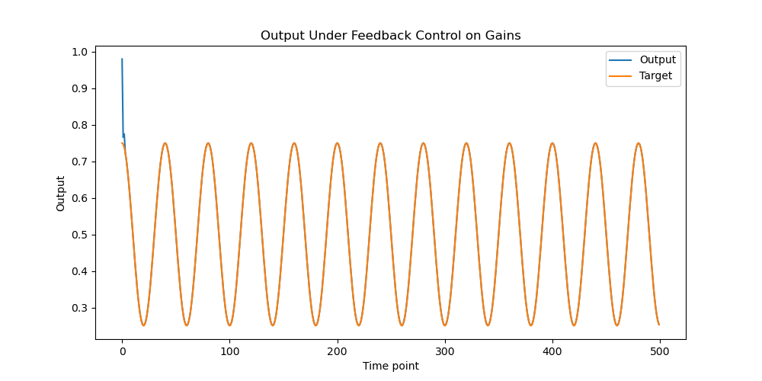
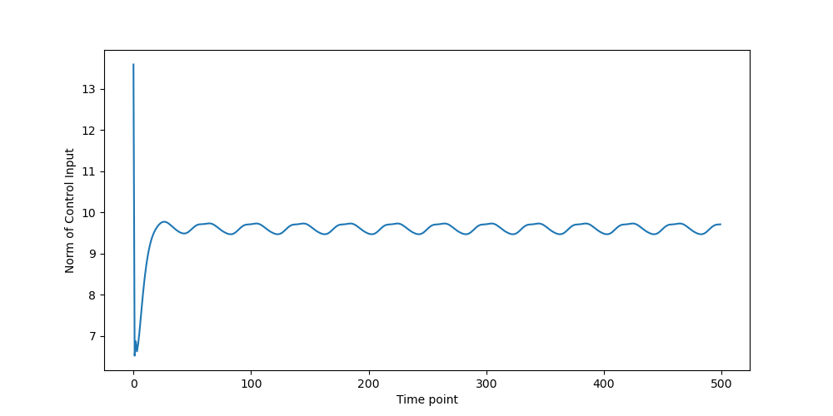
3. RNN

Slide 32
3. RNN
Structure:
Recurrent neural network (RNN)
Sigmoid activation function (with adjustable gains and shifts)
Feedback control on gains
Hebbian learning on synaptic weights (readout weights)
Properties:
Transfer of learning from gains to weights

Slide 33
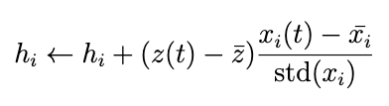
3. RNN
Step 1: Make the initial network to output the target using feedback control
Step 2: Hebbian learning on readout weights
W
$$x_{t+1}=σ\left(−(g+u_{t})\left(Wx_{t}+I_{t}−s\right)\right)$$
Readout weights H
I_{t}
y_{t}
Output z_{t}
Input
x_{t}
$${\tilde{y}}_{t}$$
$${\tilde{z}}_{t}$$
Sine wave with random phases
u_{t}
Hebbian Covariance Rule:
Nonlinear LQR
Clipping so that ext. weights >= 0, inh. weights >= 0
Normalization so that ext. and inh. weights sum constant
Notes:
Hebbian correlation rule does not work
the readout weights would converge to a point where each weight is proportional to the mean activation of the corresponding node

Slide 34
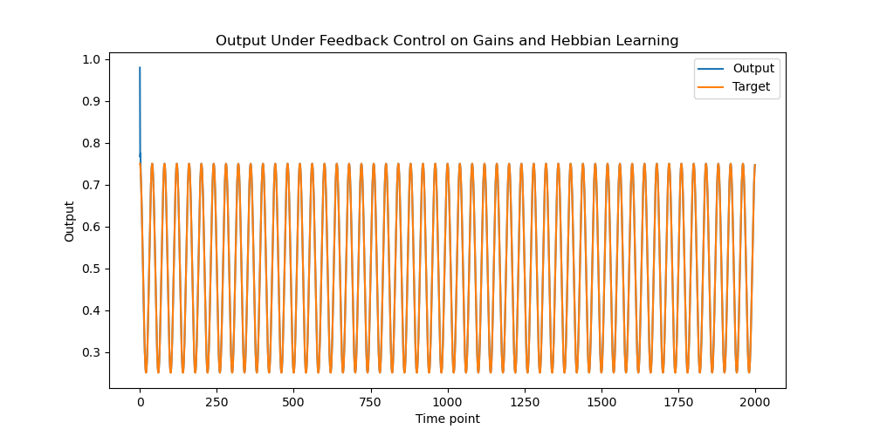
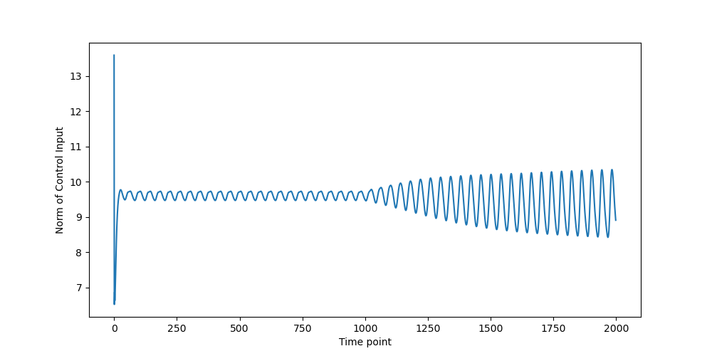
3. RNN

Slide 35
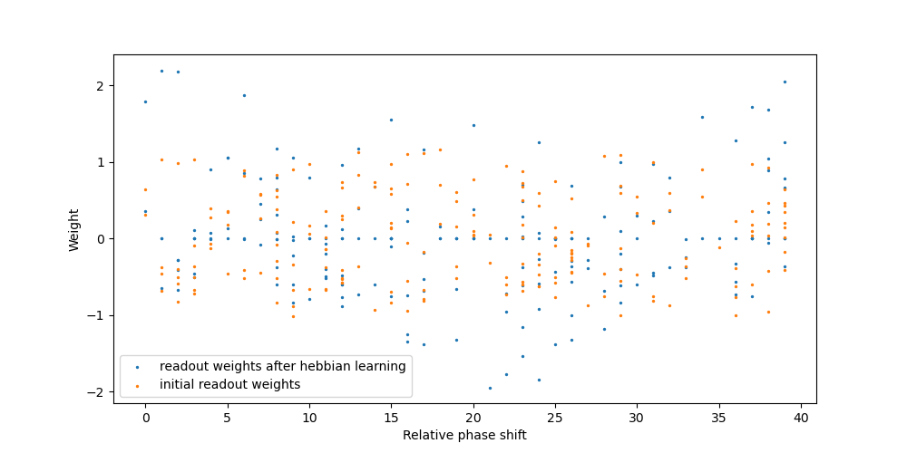
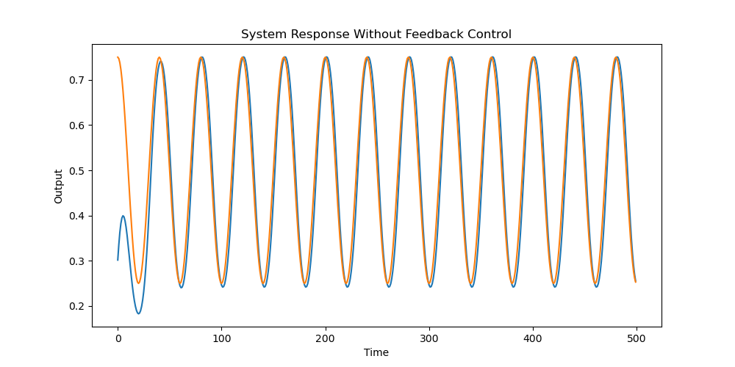
3. RNN

Slide 36
4. Biologically Realistic Controller?

Slide 37
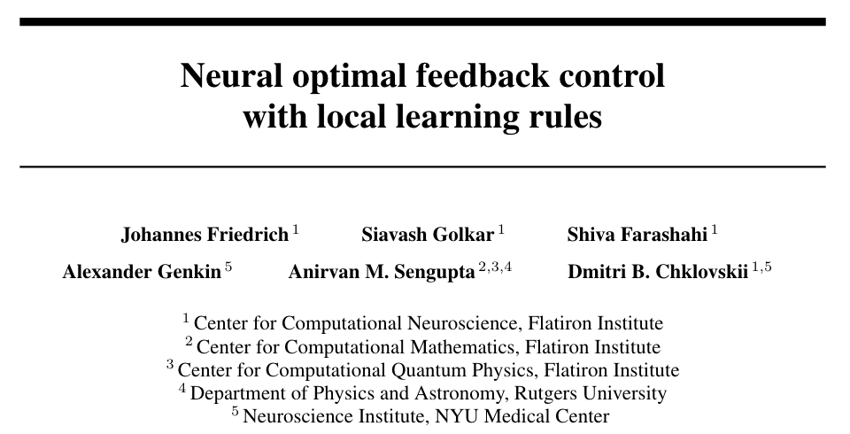
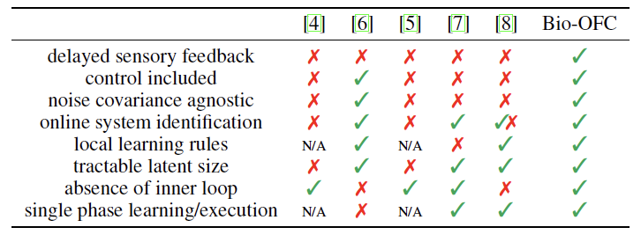
4. Biologically Realistic Controller?

Slide 38
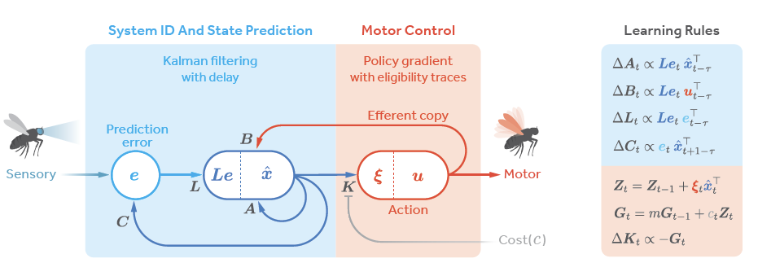


4. Biologically Realistic Controller?
Hebbian learning for C
Local (but non-Hebbian) learning for A, B, L
Policy gradient method for K

Slide 39

4. Biologically Realistic Controller?
Use a single hidden layer neural network to design a nonlinear controller

Slide 40


Supplementary figure: Hebbian learning on target

